Slide 1

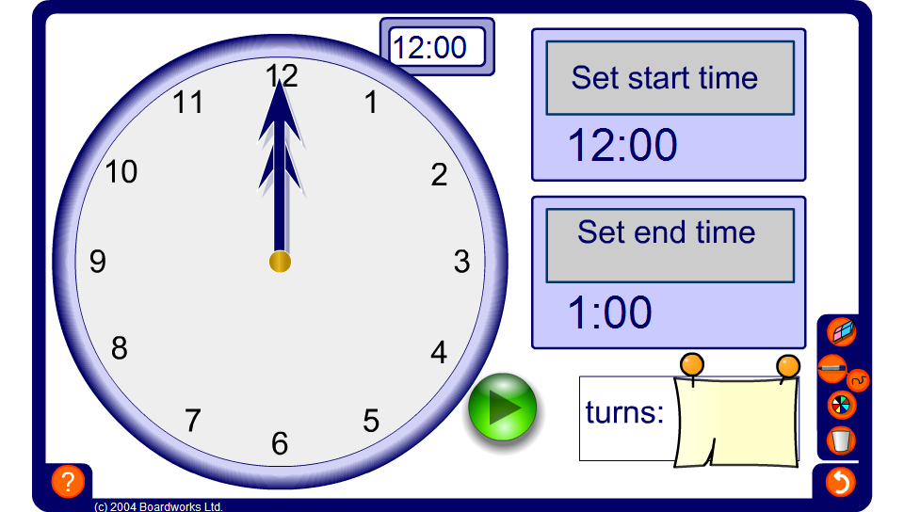


Fractions on a clock face
Notes:
Use this tool to ask pupils for fractions turned through by the minute hand between two given times.
As an extension ask pupil to determine the fraction turned through by the hour hand between two given times.
In the case of the minute hand one full turn represents 60 minutes. Pupils must therefore calculate the number of minutes between the two times given and write this as a fraction out of 60.
In the case of the hour hand one full turn represents 12 hours (or 720 minutes). Pupils must therefore calculate the number of hours between the two times given and write this as a fraction out of 12. Alternatively they can calculate the number of minutes between the two times given and write this as a fraction out of 720.

